Slide 1
20220405
Tianlong Zhou

Slide 2
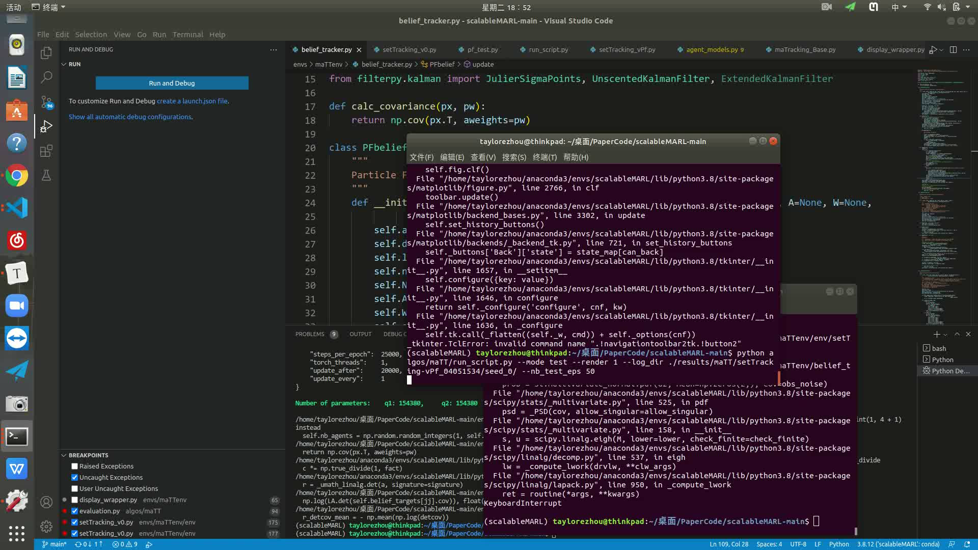
PF + scalableMARL

Slide 3
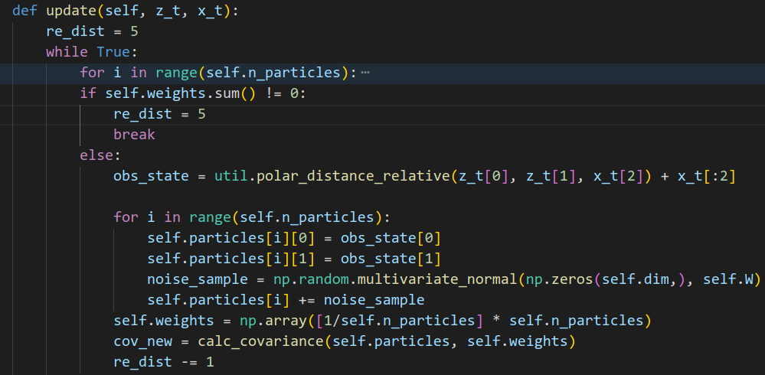
Code
In this environment, unlike Kalman Filter, Particle Filter need to resolve two problems:
Global localization experiment
Kidnapping robot experiment
Because there will be several predict steps before a update step.

